Slide 1
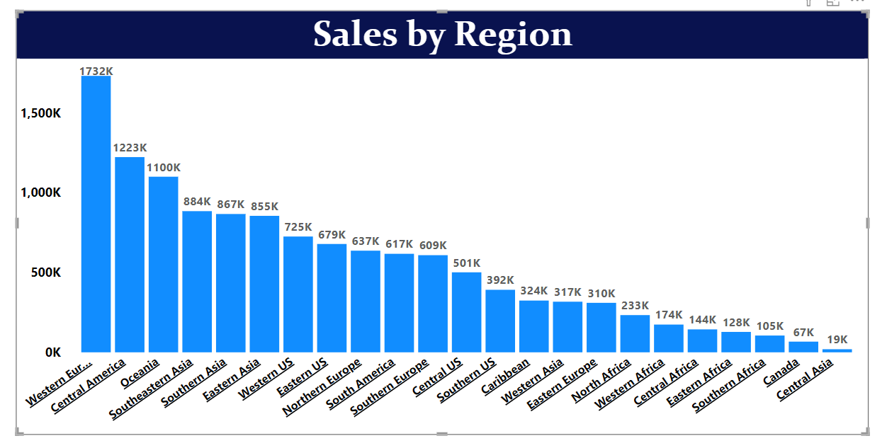
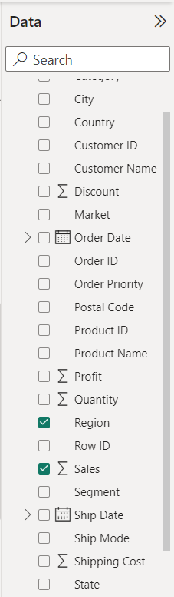
Stacked Column Chart
stacked column chart is a visualization that displays data in vertical columns, where each column represents a category or group, and the height of each segment within the column represents a subcategory or a specific data value.
For this kind of chart we need two types of data:
1 text (Less Distribution). E.x –Region, Category, State
1 Numerical Data. E.x- Sales, Quantity

Slide 2
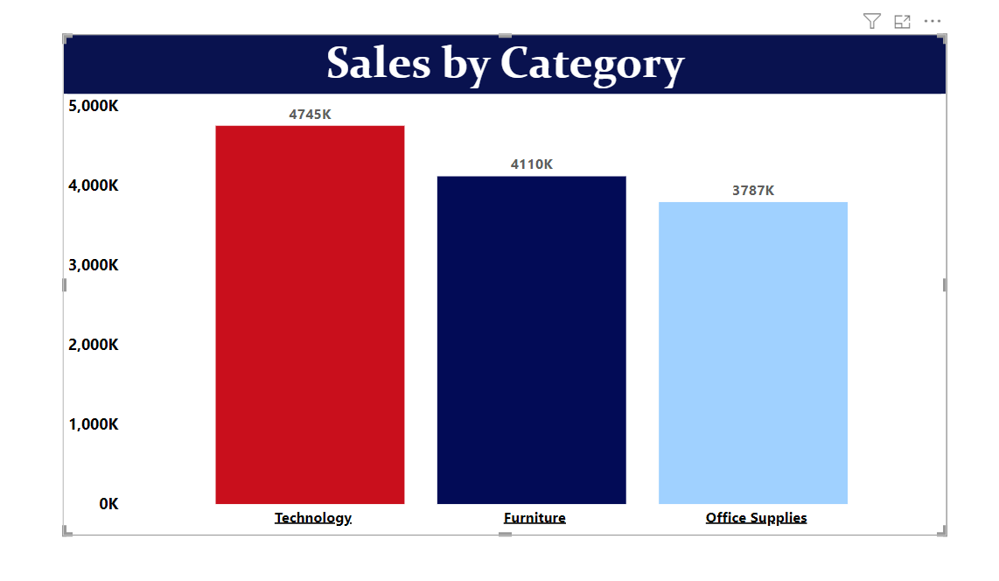
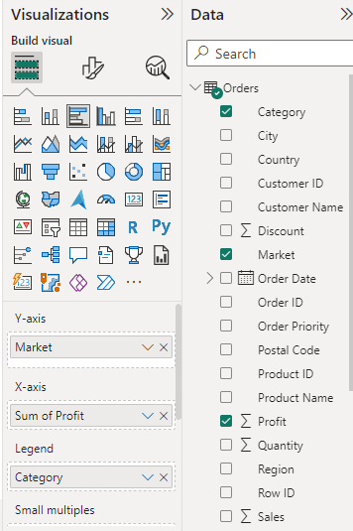
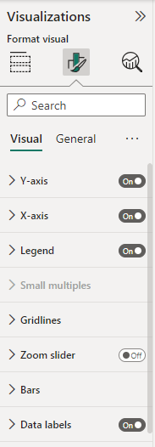
After the successful, creation of a Stacked Column chart in Power BI. We have multiple options to format it. For example, adding the title to the chart, changing the color, and position of the chart, and adding tooltips, bar colors, and data labels to the chart. Stacked column chart is interactive, allowing users to drill down into the data, filter, and explore different dimensions.

